Slide 1
Valve Control System
Patrick Borgman, Austin McCright, Jaimie Thomas, Harun Resulovic

Slide 2
Problem Statement
Surf Rover needs an electrical system used to control hydraulic components for steering and propulsion.
Power electronics will also be needed to regulate and distribute correct voltages to necessary parts of rover.
Communication system needed for interaction between rover and user.

Slide 3

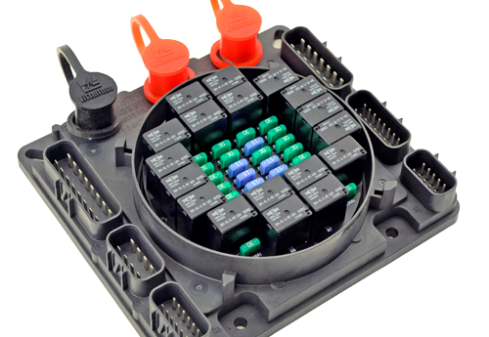
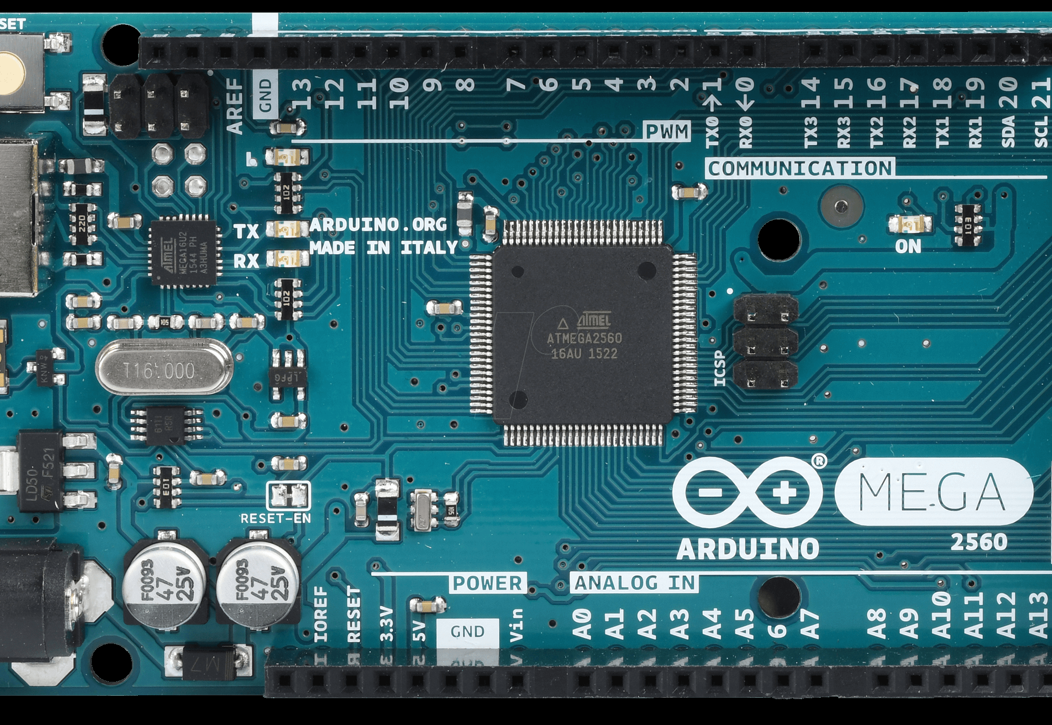
Initial Design
The Brains: Arduino Mega (Atmel AtMega 2560)
The Muscle: 24-V solenoid bypass valves, Hydraulic Motors, Hydraulic Rams
The Heart: Power Distribution Module (PDM)

Slide 4
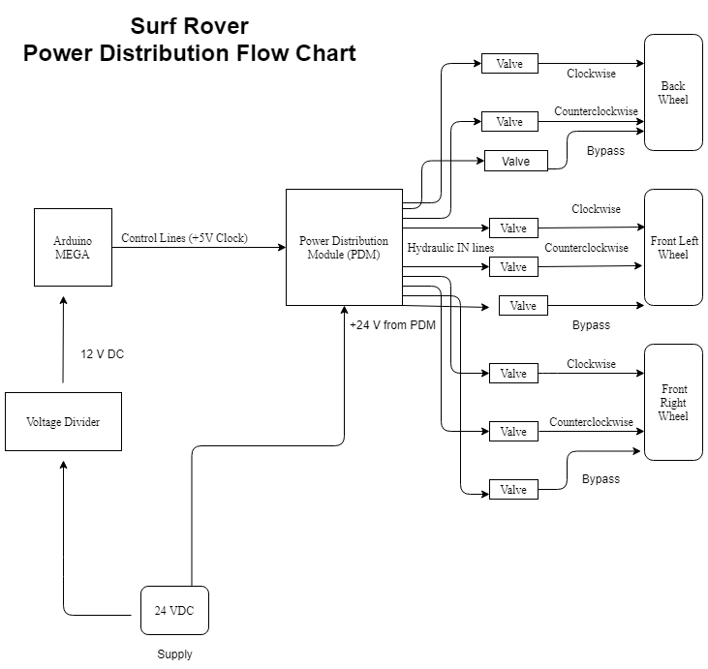
Initial Design
Originally a 12V battery was to be used; replaced with 24V due to valves
PDM would reroute power to where it was needed based on input from Arduino Mega
In total, needs to power nine valves, three per wheel. These include the control valves and a bypass valve.

Slide 5
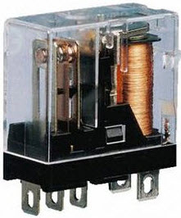
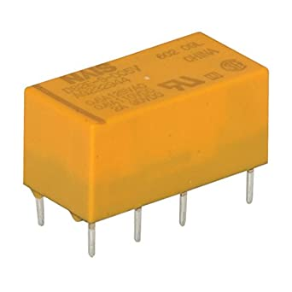
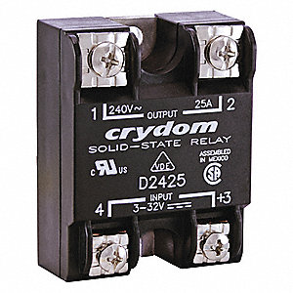
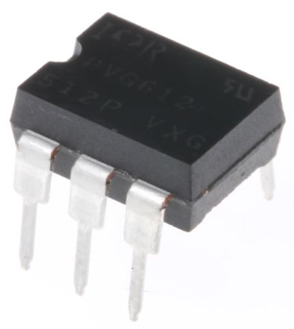
Design Changes
PDM distributes power using electromechanical relays or switches
However, it was determined that solid state relays would be more dependable and durable for use on an aquatic vehicle (details next slide)
Design changed to use bank of solid state relays
Electromechanical Relays
Solid State Relays

Slide 6
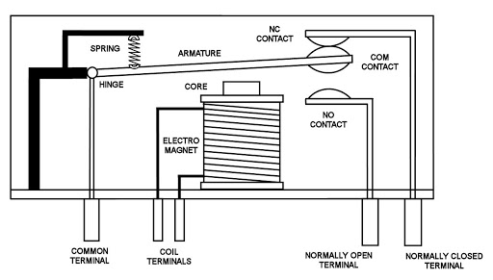
Electromechanical Relays
Powering the relay magnetizes the coils, causing armature to change position
Spring returns arm to original position when the coil is demagnetized
Because of the vibration of rover, there was concern that the arm would make contact unintentionally
Internal Diagram of EM relay

Slide 7

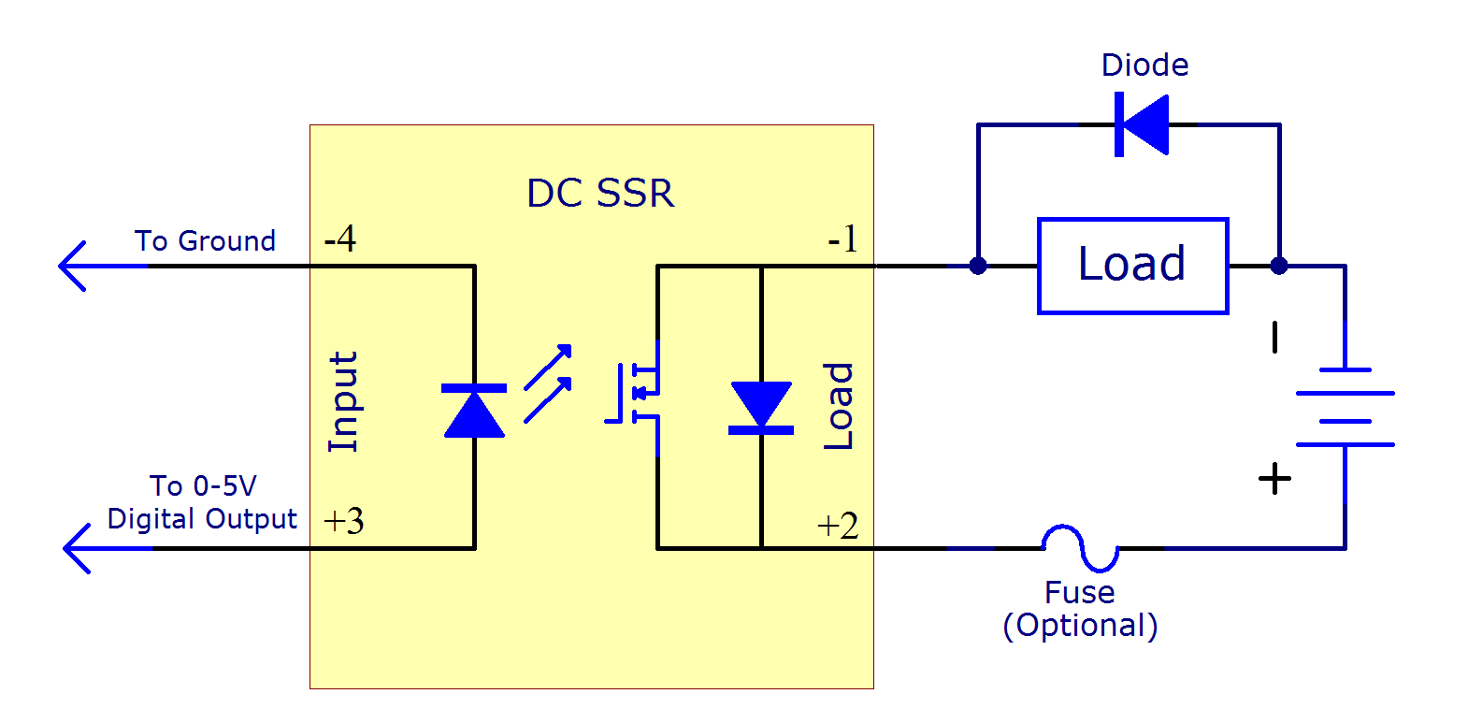



Solid State Relays (SSRs)
When powered, turns on internal LED
Photo-sensitive transistors are then activated and close the output circuit
Input and output circuits are electrically isolated, increasing protection in case of failure ("optocoupled" or "opto-isolated")
No moving parts so more resistant to vibrations of surf rover
Internal diagram of SSR

Slide 8
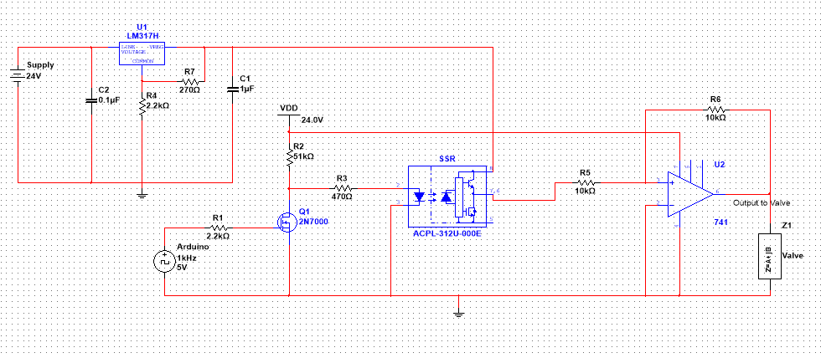
Final Design

Slide 9
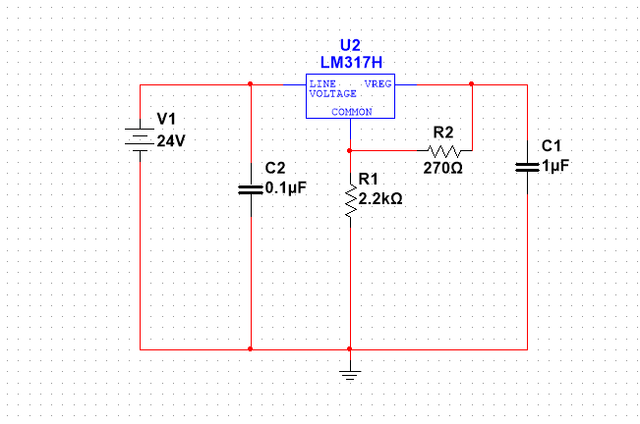
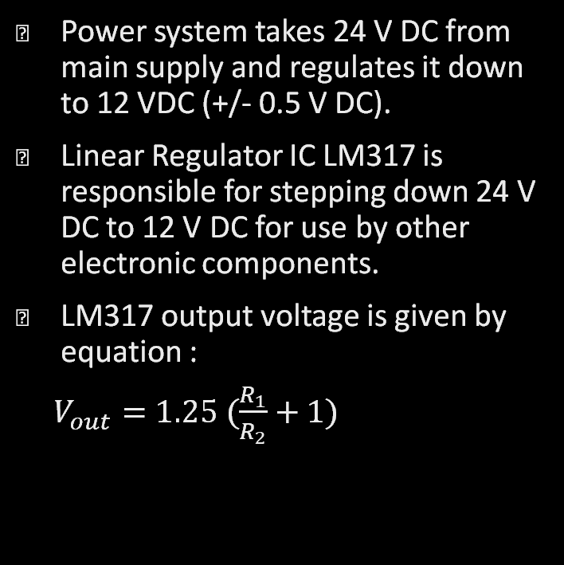
Stage 1: Power System
Power system takes 24 V DC from main supply and regulates it down to 12 VDC (+/- 0.5 V DC).
Linear Regulator IC LM317 is responsible for stepping down 24 V DC to 12 V DC for use by other electronic components.
LM317 output voltage is given by equation :
$V_{out}=1.25 (\frac{R_{1}}{R_{2}}+1)$

Slide 10
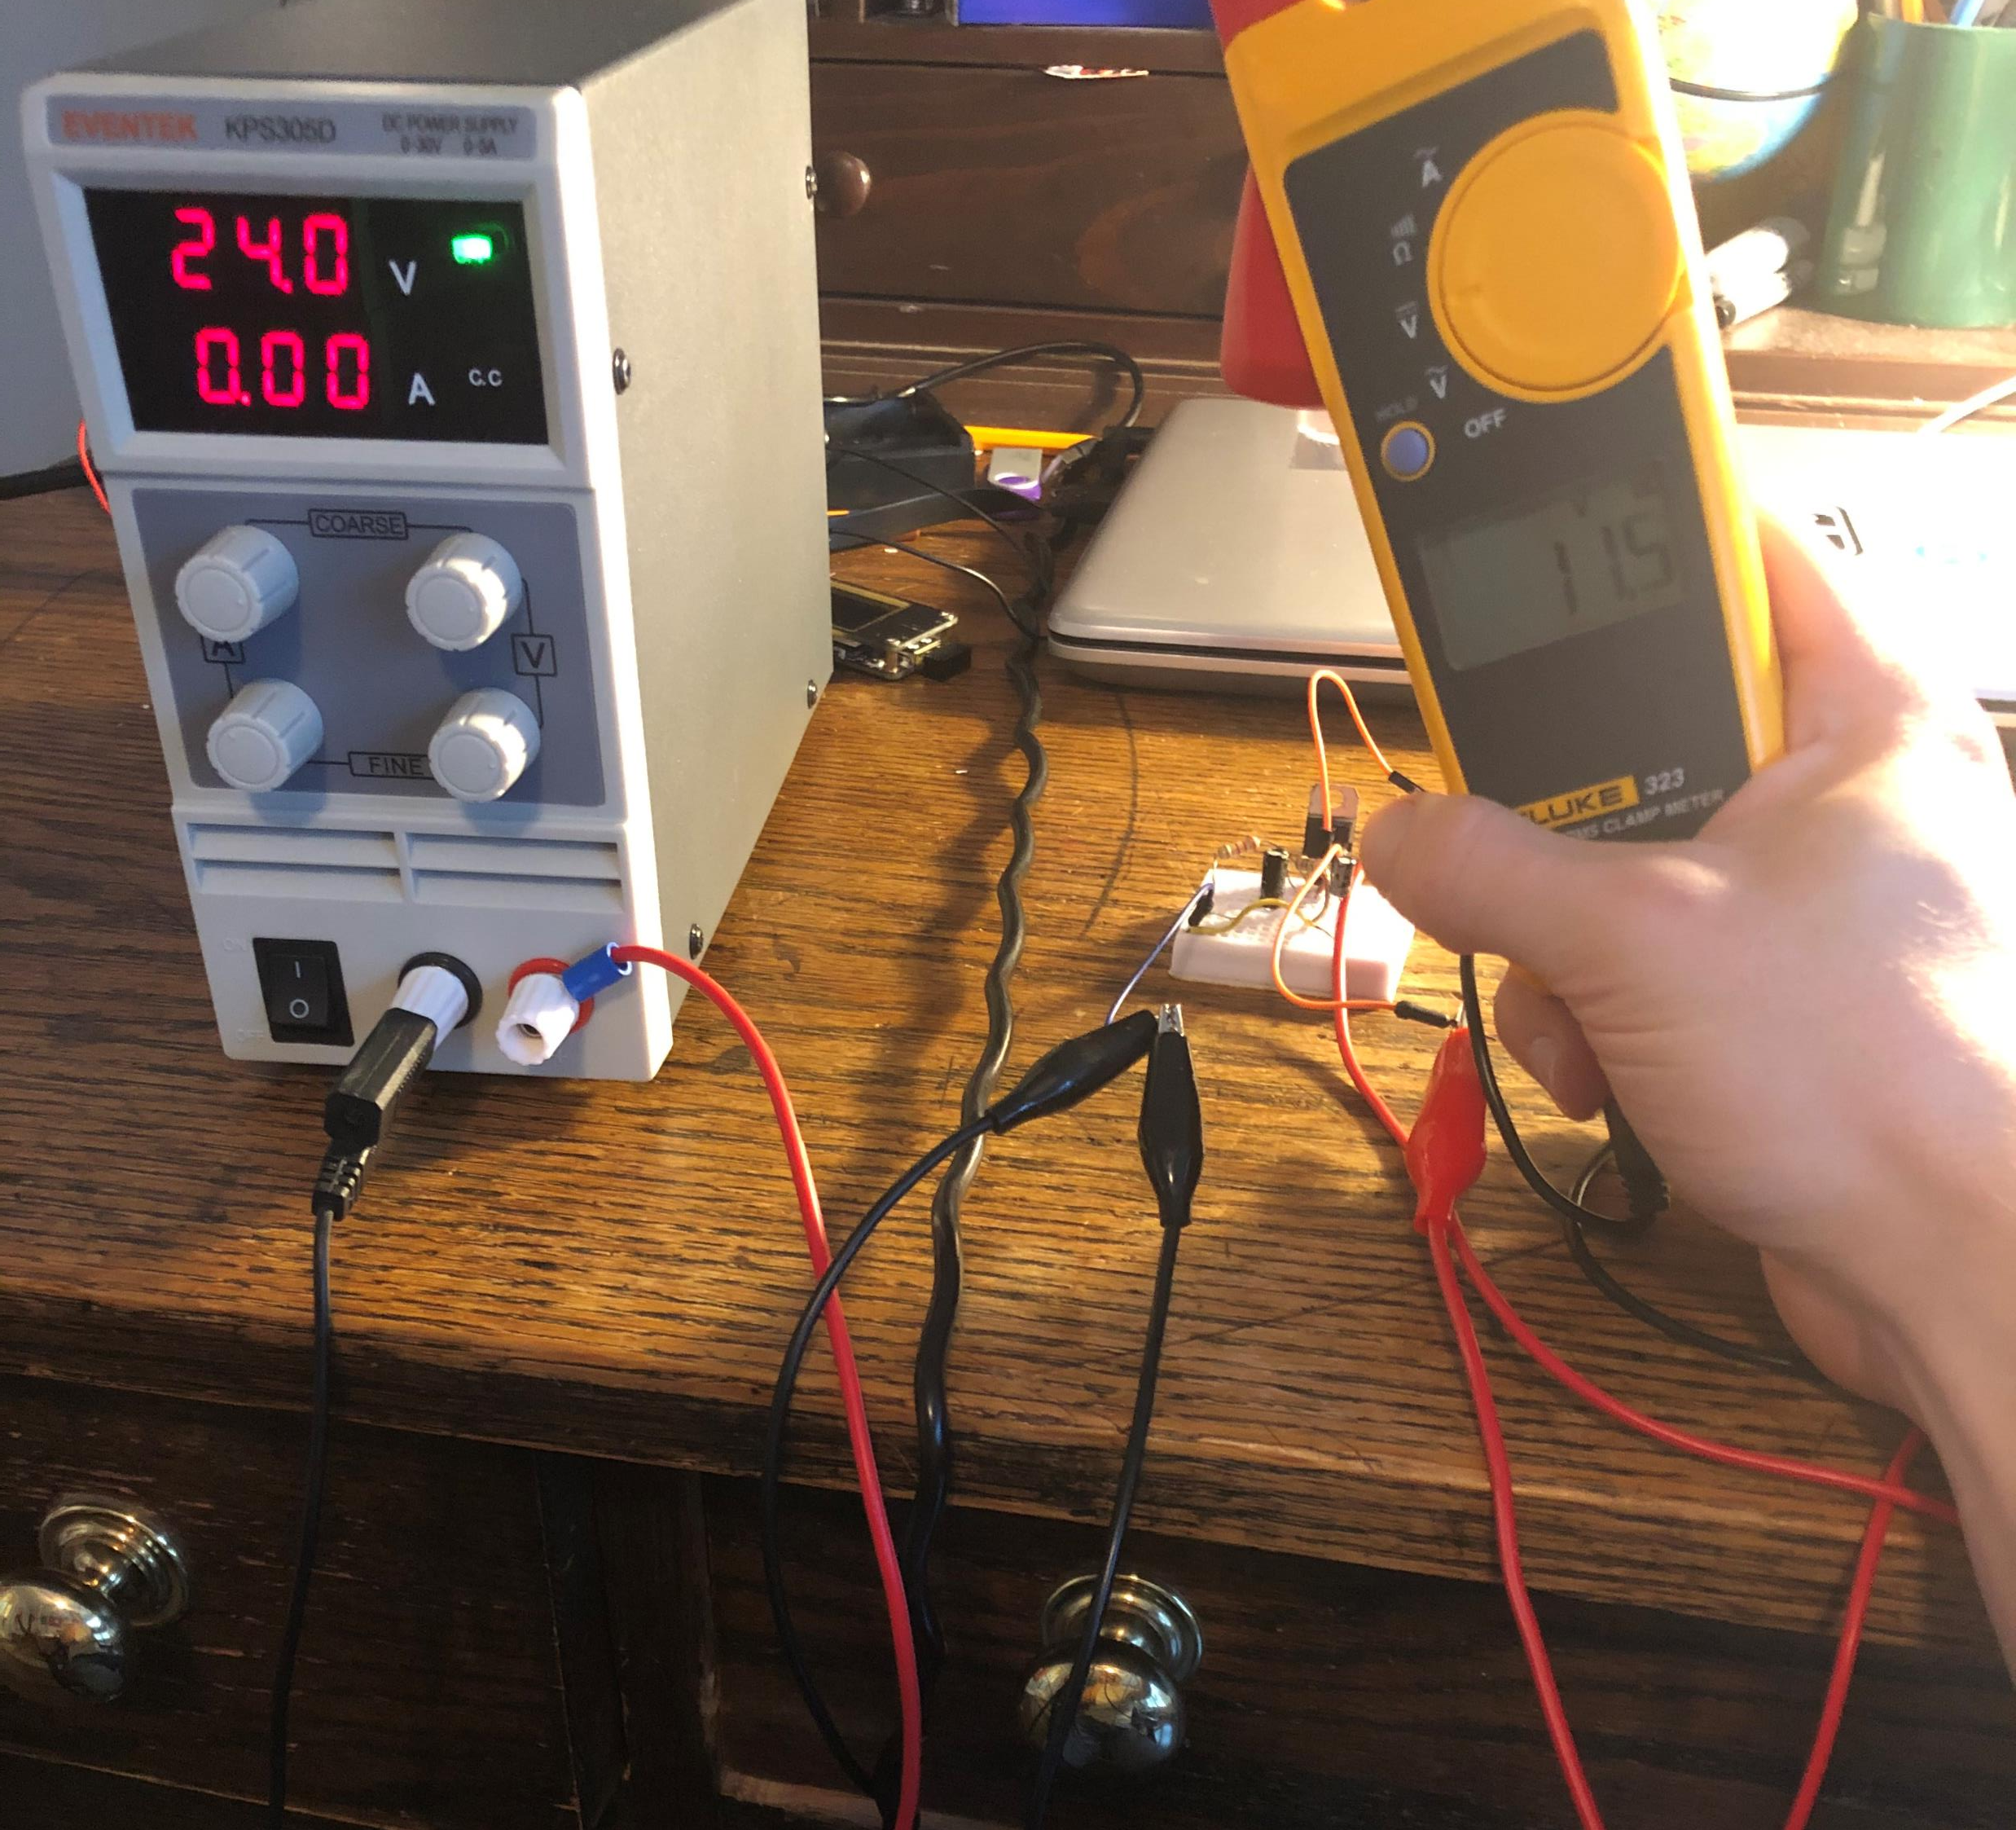
Proof of Concept

Slide 11
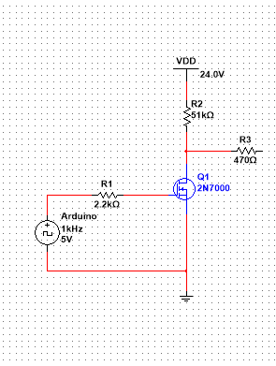
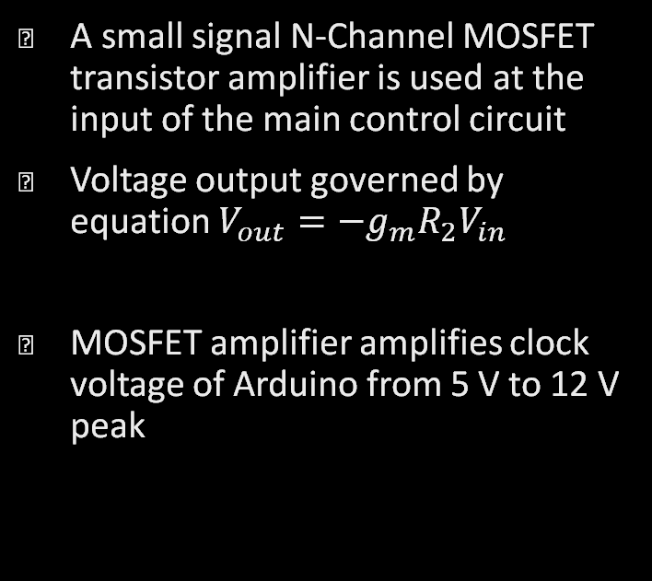
Stage 2: Input Amplifier
A small signal N-Channel MOSFET transistor amplifier is used at the input of the main control circuit
Voltage output governed by equation $V_{out}=−g_{m}R_{2}V_{in}$
MOSFET amplifier amplifies clock voltage of Arduino from 5 V to 12 V peak

Slide 12
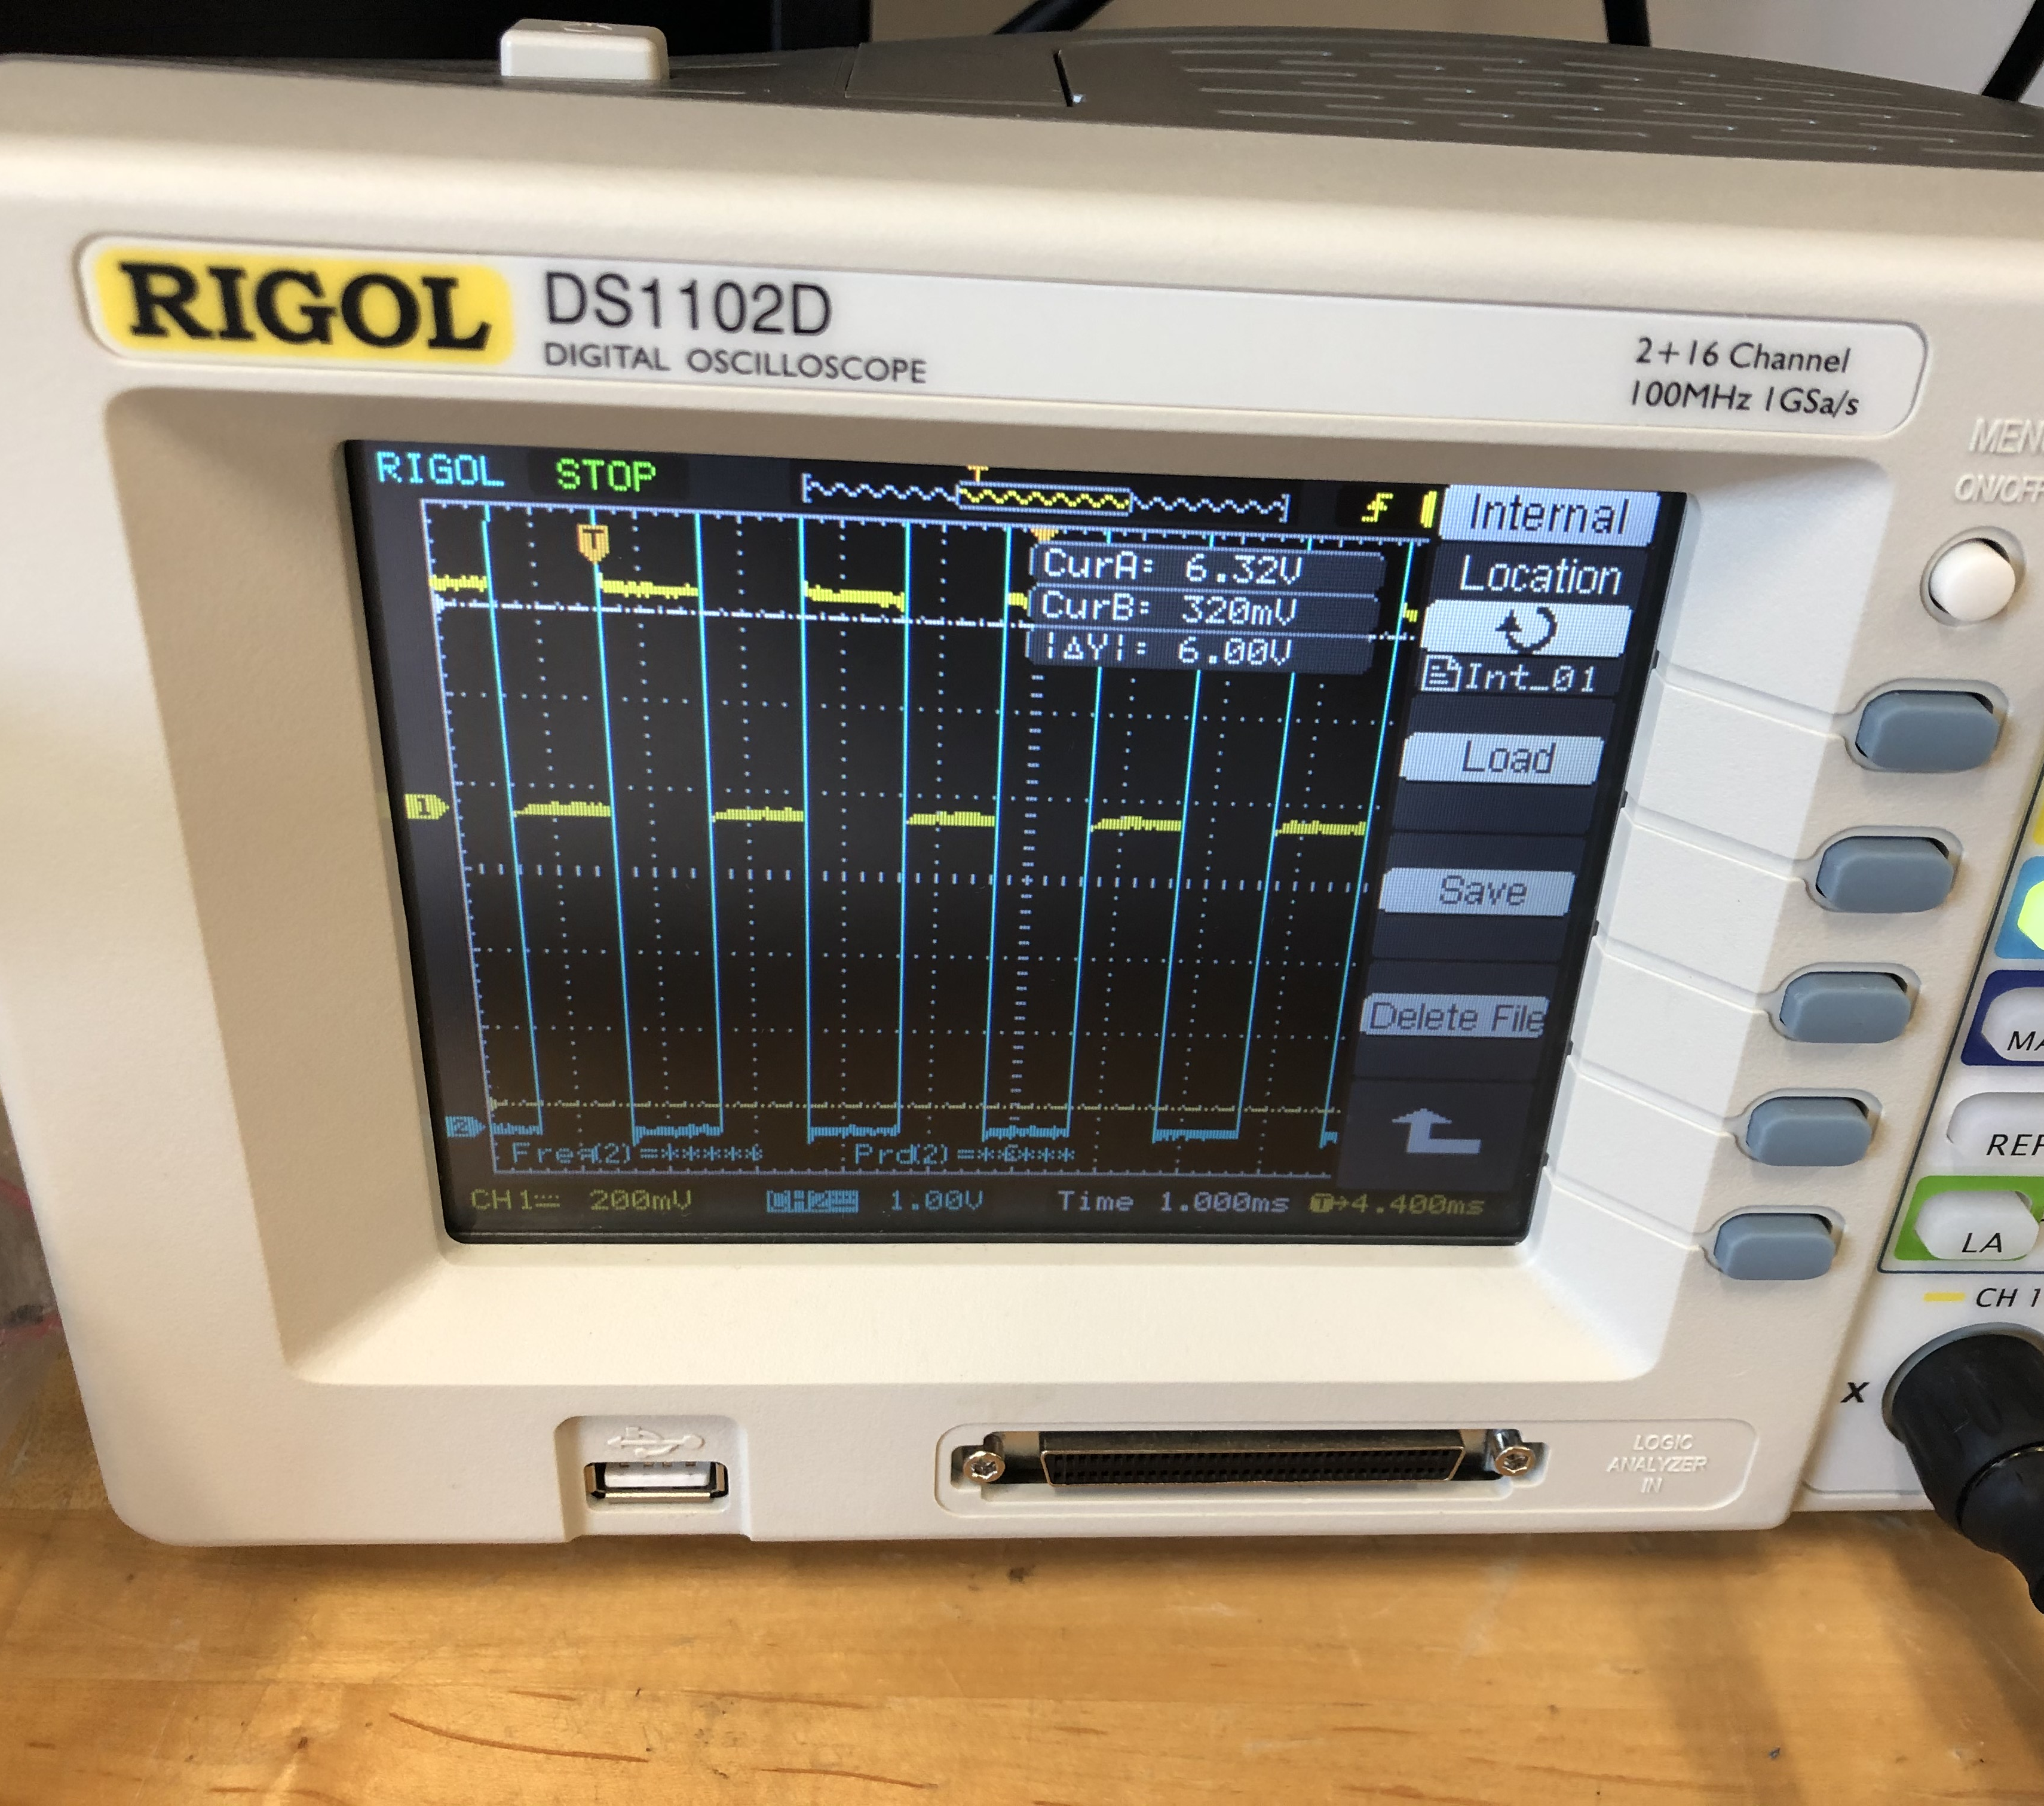
Proof Of Concept

Slide 13
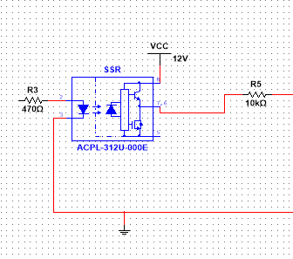
Stage 3: Solid State Relay
Takes 12 VDC peak digital output signal from MOSFET amplifier.
Optocoupling converts electrical pulse into infrared light signal using an IR LED.
IR light pulse is received by photodiode at SSR output to ‘switch on’ the relay.

Slide 14
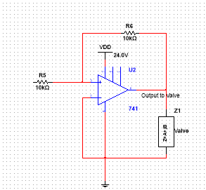

Stage 4: Output Op Amp
A 741 operational amplifier IC is used to double each output from SSR.
Op amp ensures that solenoid valves receive 24 volts they need.
Output voltage is governed by equation $V_{out}=(\frac{R_{f}}{R_{i}}+1)V_{in}$

Slide 15
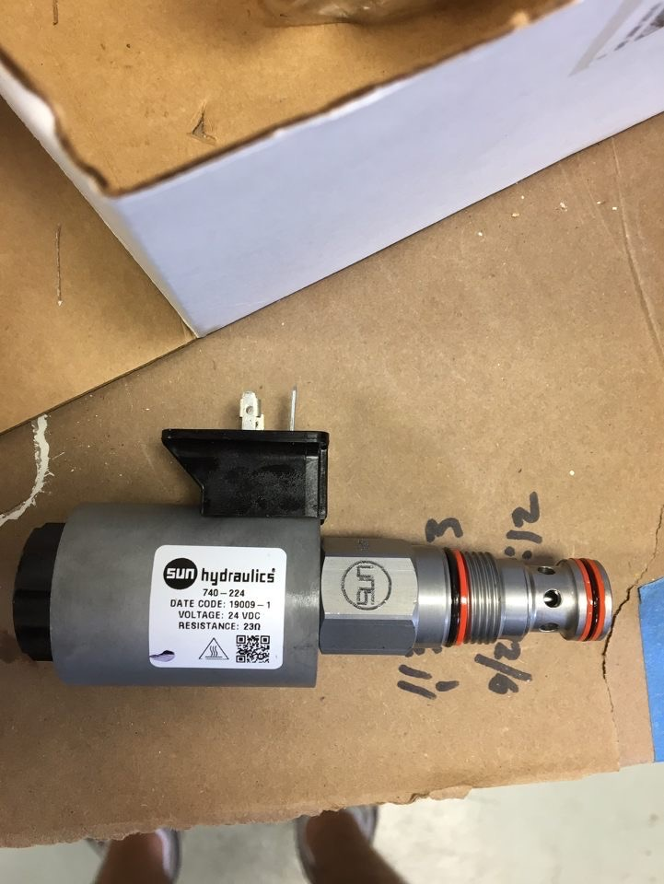
Stage 5: The Bypass Valves and Solenoids
+24 V DC hydraulic valves are used to allow rover tracks to spin freely if voltage is lost. 2 for each track (6 valves), 3 tracks on the Rover. During normal operation, the valves are electronically held closed.
Surf Rover will be equipped with 3 bypass valves, one for each of the three tracks.
Each Track also has a motor and each motor has two solenoids based on which solenoid is energized will determine which direction the track will rotate.
One solenoid is responsible for clockwise rotation, while the other is responsible for counterclockwise rotation.

Slide 16
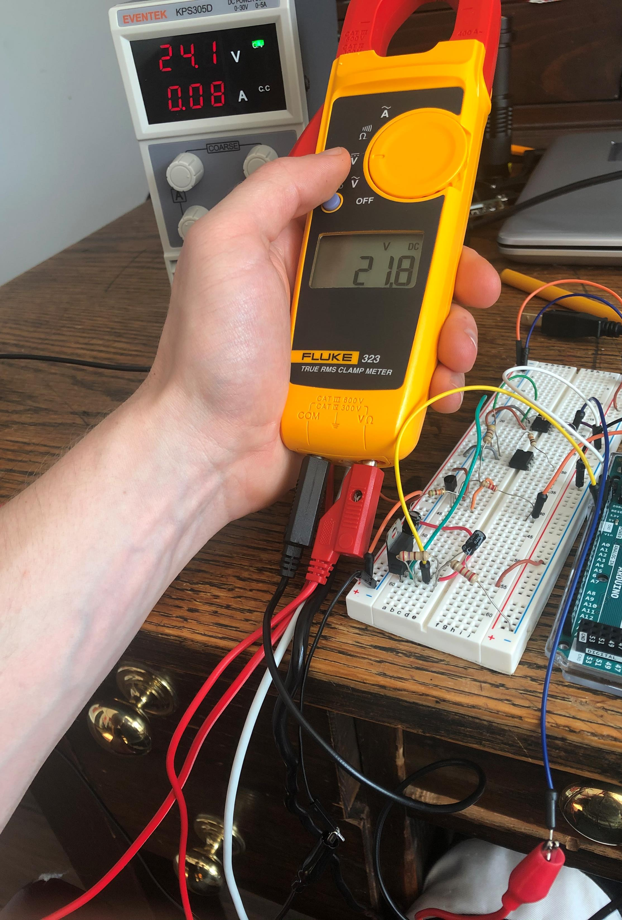
Final Circuit Proof of Concept

Slide 17

Next Steps (Moving Forward)
A main and backup Communication System (a way to talk to the Rover)
Live data transmission (transfer of data into and out of the Rover)
PCB design and milling for final control circuit.

Slide 18
On-Board Communications
Implementation of a Transmitter and Receiver are to be much needed for the Rover, in terms of communication, as well as a backup system.
The idea for the backup system is that when the Rover is to stop operating, there is a backup system implemented in the Rover to help kickstart it again.
Two components used, the Tx (Transmitter) and the Rx (Receiver).
Give control circuit a clock signal and amplify that signal. This signal will come from a RF (feedback) transmitter to receiver.
Initially the Arduino Board was used to generate a 5V square clock pulse.
Goal moving forward, is to implement these two components into Arduino (coding) to help develop a backup system for the Rover.

Slide 19
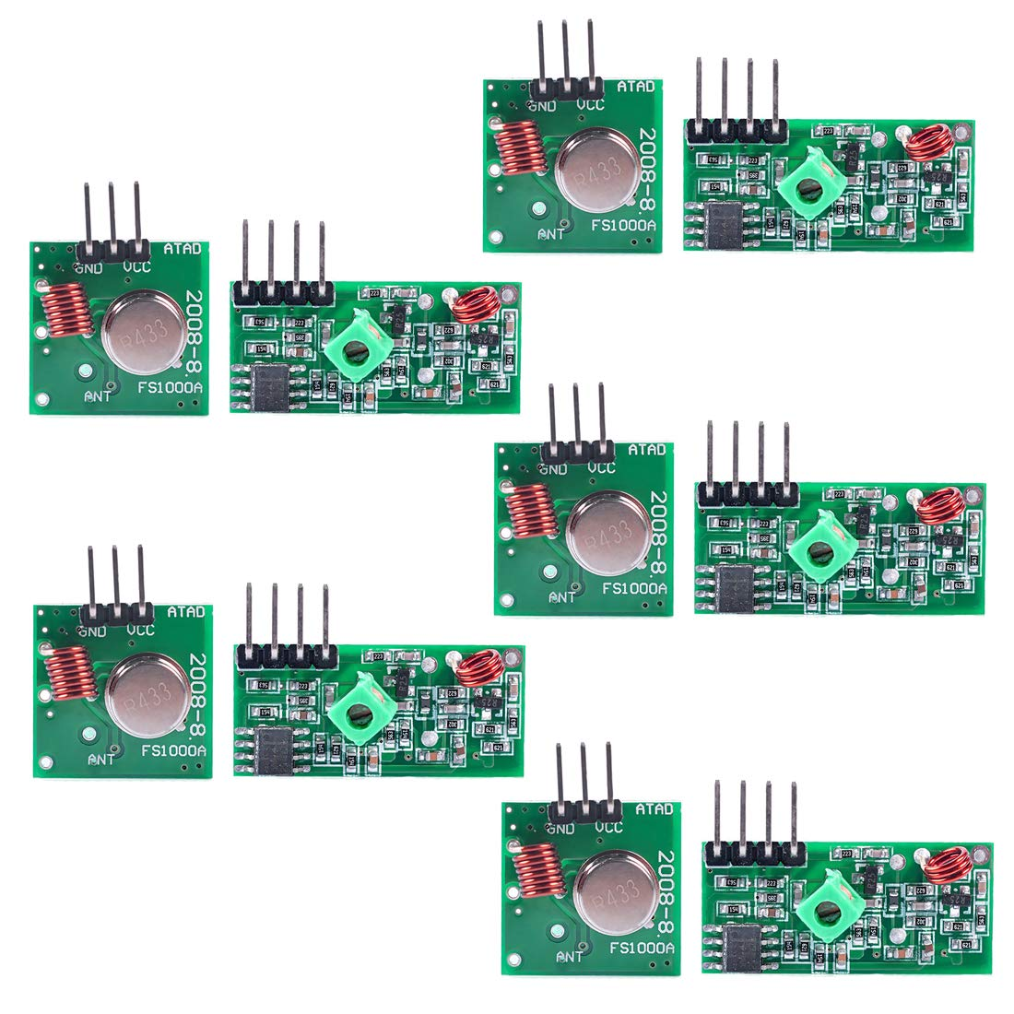
Photo of Tx (Transmitter) and Rx (Receiver)

Slide 20
PCB Design/Milling
Although a breadboard was used for testing purposes, A PCB will eventually have to be designed and milled.
PCB must accommodate nine units of the final design circuit, since nine hydraulic valves and solenoids will be used for Surf Rover mobility, as well as the RF communications setup.

Slide 21

Q & A

